Slide 1
NEM ReST Service Gateway & Swagger Template Changes
NEM DA submission: 23 May 2018
Status: draft
Document version: 0.2
Author: Stephen Rea
Discussed with: Jasper Thorburn, Patrick Herring

Slide 2
Summary of Proposal
Alter Service Gateway routing logic to cater for cache misses.
Mandate Service Gateway specific header fields as mandatory for ReST services.
Restrict patterns tied to the allowed values for these fields.

Slide 3
Problem Statement & Context
Gateways were first introduced for SOAP based services; where existing SOAP services were already being consumed prior to their introduction. To accommodate older consumers (v1 service header) adopting gateways without change, service gateway specific service header fields were defined as optional.
For ReST based service operations, older consumers (pre gateway) do not exist; therefore we should tighten the rules to force design, dev & test to cater for the inclusion of gateway management.

Slide 4
Proposed SG Routing Changes
VirtualEnvironment & SchemaVersion values are taken as is and a hit in the cache is attempted.
Following a miss we then always route to the default routing decision for that major API version and targeted operation.
If a default hit is not achieved the gateway throws an exception and an error response is returned; thereafter the miss is logged.

Slide 5
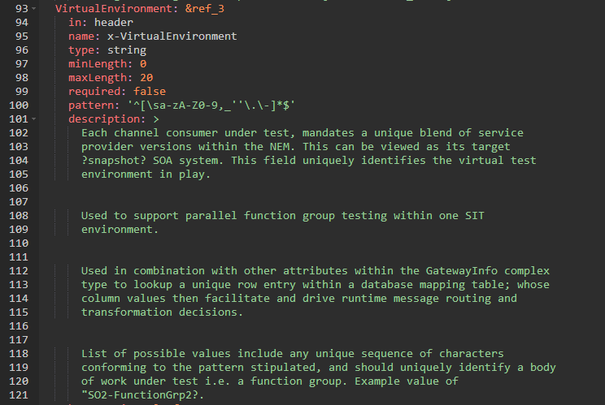
SG VirtualEnvironment Field Definition

Slide 6
Proposed SG VirtualEnvironment Field Changes
Change required to: true.
Remove min & max length.
Additionally, restrict pattern tied to the allowed values for this field: '^[A-Z0-9,\.\-]{1,20}$’
In test environments the virtualEnvironment field value will be a concatenation of:
An acronym representing the release under which change is being introduced.
A concatenation of other (as yet unspecified) service header fields that together uniquely identify a specific actor in the channel.
In production the acronym part of this value will be removed.

Slide 7
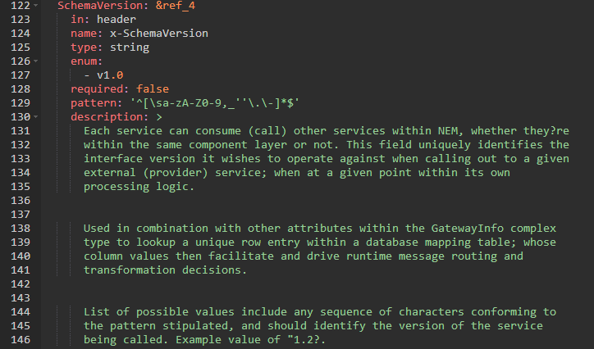
SG SchemaVersion Field Definition

Slide 8
Proposed SG SchemaVersion Field Changes
Change required to: true.
Change enum to:
2.0
So remove ‘v’ e.g. change v2.0 to 2.0
Additionally, restrict pattern tied to the allowed values for this field: '^([1-9]|[1-9][0-9])\.[1-9]??[0-9]$'

Slide 9
SG VirtualEnvironment Production Example
Production N
Production N+1
Release EM2D2
Release EM2D2
Channel Consumer Actor Y
Channel Consumer Actor X
Channel Consumer Actor X
VE=EM2D2
SV=2.1
VE=EM2D2
SV=2.1
VE=TRANSFORMR1
SV=2.1
IPM_REIPAD_SG
IPM_REIPAD_SG
Changed “In-Scope” Content for Transform Release One
IPM_v2_1_ REIPAD
IPM_v2_1_ REIPAD
VE=EM2D2
SV=3.1
VE=EM2D2
SV=3.1
Operation | schema Version | virtualEnvironment | Route to:
RPD | V3.1 | EM2D2 | RPDv3.1
RPD | V3.1 | TRANSFORMR1 | RPDv3.2
PPM_RPD_SG
PPM_RPD_SG
9
PPM_v3_2_ RPD
PPM_v3_1_ RPD
PPM_v3_1_ RPD

Slide 10
SG VirtualEnvironment Benefits
Delivery flexibility:
It is not always possible to schedule the migration of all impacted consumers within a given release plan. Using a virtual environment mitigates the need to perform regression testing on unchanged “out of release scope” content.
Production deploy & live proving resilience:
Its not always desirable to force migration on mass, as its safer to mitigate risk by staggering the migration of affected consumers during live proving and optionally across releases.
The regression testing of original production content, during live proving, should prove lower risk. Original content and its endpoint routing configuration can remain unchanged, isolated by virtue of the release (virtual environment) such content was originally deployed under.
Once old and new content is stable, planned and targeted production cut over regression testing can be applied where decommissioning has been identified. This activity offers lower risk as isolated routing decisions can be quickly reversed on a case by case basis, where the migration of an older consumer has failed and this is blocking the reintroduction of an offline site (a risk in itself).

